Slide 1
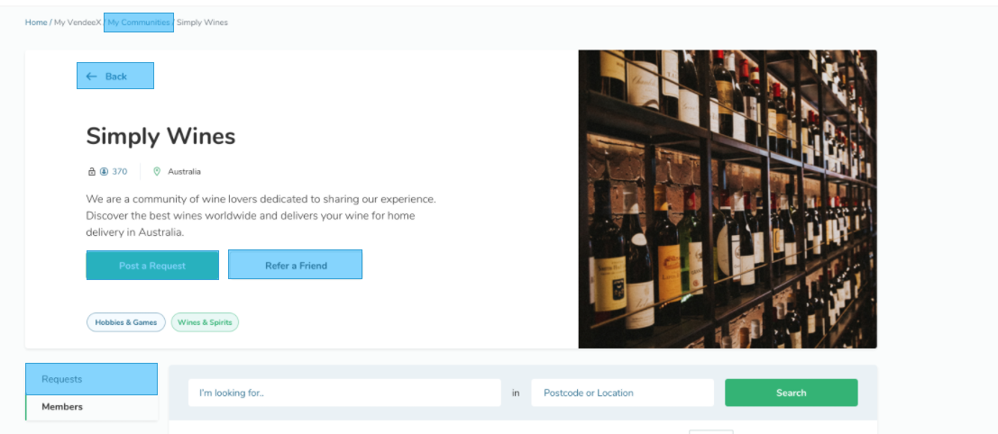
this image is too big

Slide 2
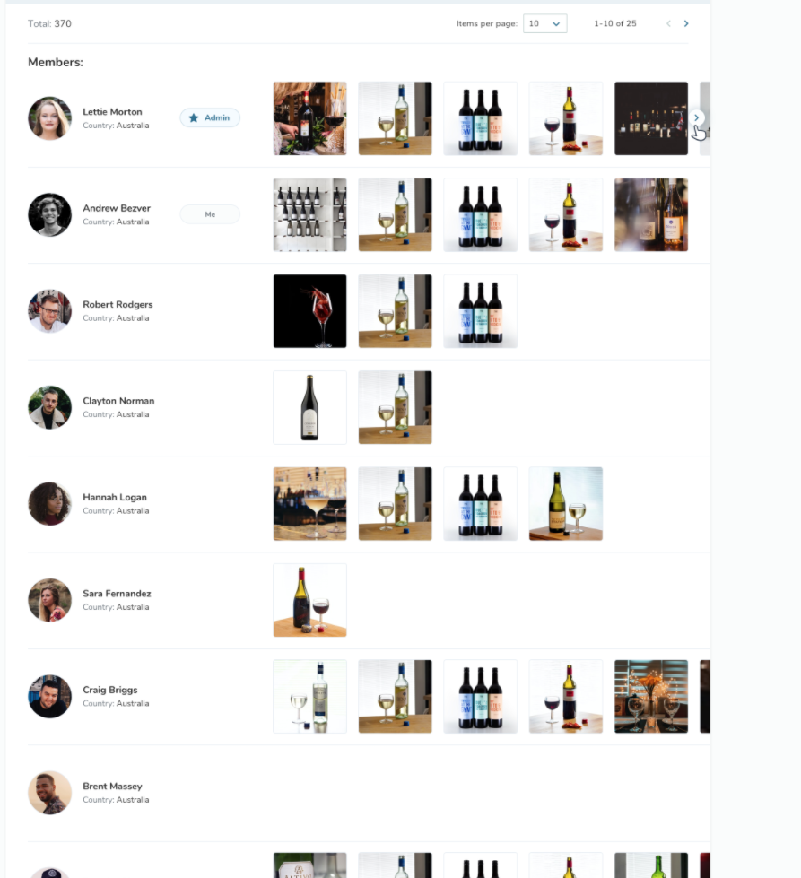
this is beautiful ....
I do have a concern about the ability for this to scale to volume
how do we manage 10,000 listings per day?
how do we manage 90,000 members of one community group?
* we need to be able to search and sort members
* Current Requests could be displayed as you have it on this page, but not the old requests – old requests should be archived

